Slide 1
Python - The basic!

Slide 2
Lesson 0: Hello World! - Your First Python Program

Slide 3
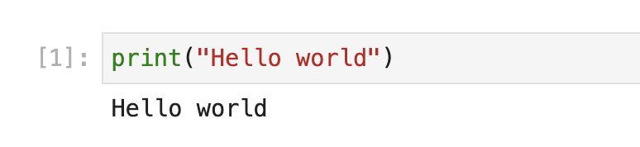
Running your first code
https://gto76.github.io/python-cheatsheet/

Slide 4
Comments
# Display “Hello world” text
print(“Hello world”)

Slide 5
Data Types and Variables

Slide 6
Data types

Slide 7
Data Types
In programming, data types are used to tell computer the type of data
Python has a small set of built-in types storing different type of data:
Integers (int): Whole numbers (e.g., 10, -5).
Floats (float): Decimal numbers (e.g., 3.14, -12.5).
Strings (str): Text enclosed in quotes (e.g., "Hello", 'This is a string').
Booleans (bool): True or False values.
None: empty data
Note: these built-in data type are called primitive/scalar data type

Slide 8
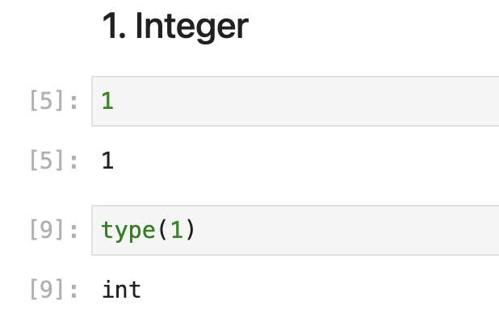

Slide 9
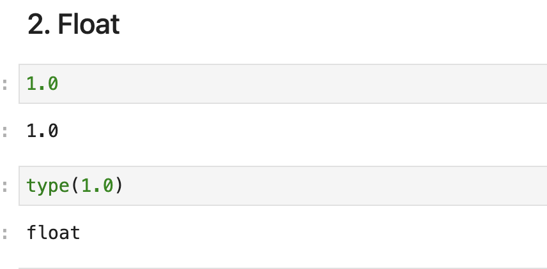

Slide 10
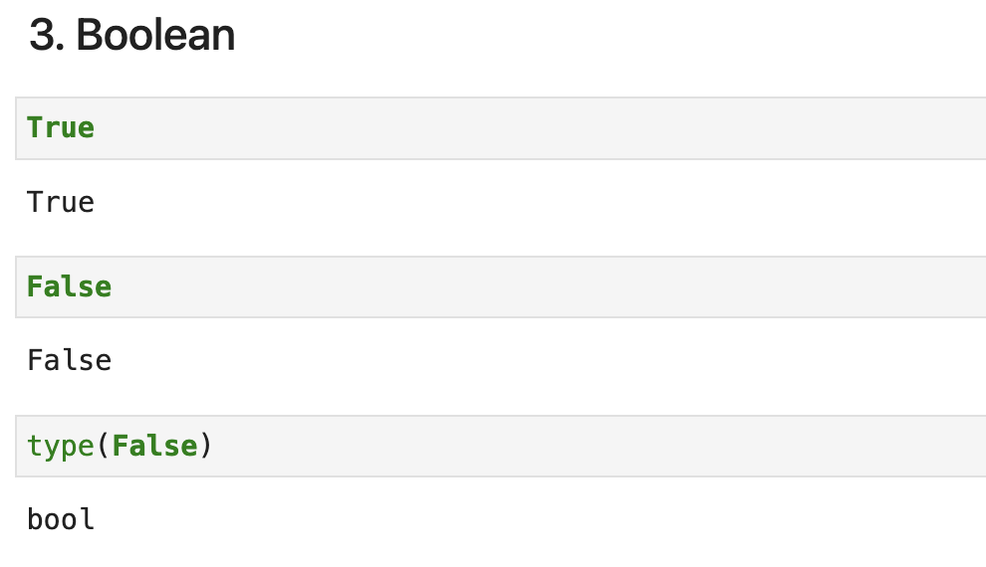

Slide 11
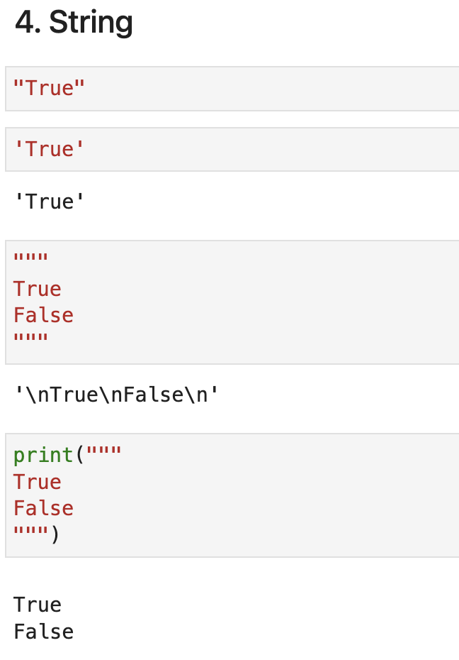
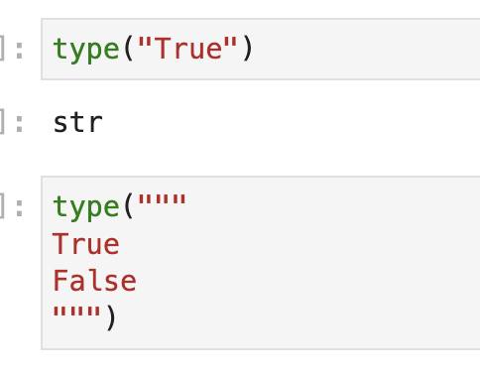

Slide 12

Problems with Floating Point
Floating-point numbers are represented in computer hardware as base-2 (binary) fractions, which can lead to unexpected precision issues.
# Example of precision loss in Python
>>> 3.3 * 33
108.89999999999999
For more details, see the official Python tutorial:
https://docs.python.org/3/tutorial/floatingpoint.html
Key Takeaway: Be mindful of precision when performing financial or scientific calculations.

Slide 13
Values and Types
Strings: '2' and '42.0' are strings because they are enclosed in quotation marks.
Number Separators: Numbers can be separated by underscores (_) for readability, e.g., 1_000_000.
Legal Values: 1,000,000 is not a legal integer in Python, though it may be a legal value in other contexts.

Slide 14
Variables

Slide 15
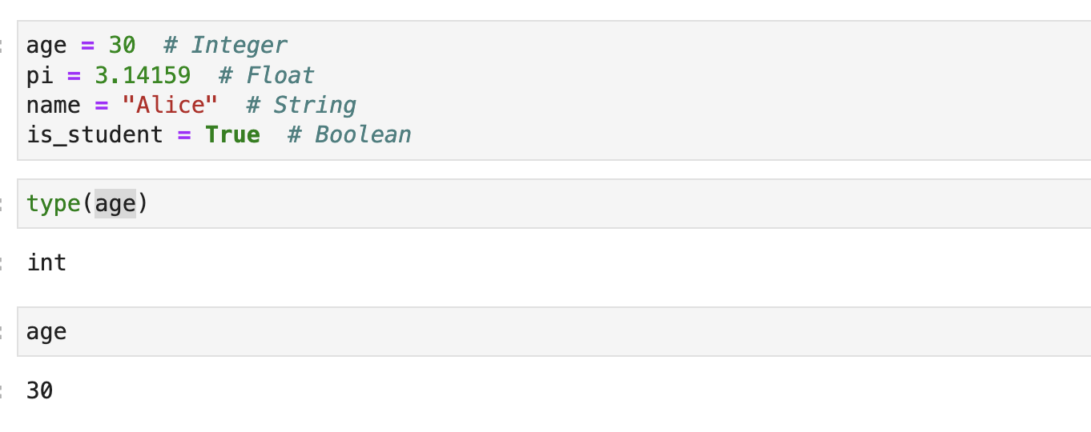
What is Variables?
Variables are containers for storing data values.
You can create a variable simply by assigning a value to it using the assignment operator (=).

Slide 16
Variable name and Identifiers
A Python identifier is a name used to identify a variable, function, class, module or other object.
Starts with a letter A-Z or a-z
Example: my_var, MY_var, 1Var
Starts with an underscore (_)
Followed by zero or more letters, underscores and digits (0-9).
Example: _MY_VAR, _VAR1, __var, _1MY_VAR
Does NOT allow punctuation characters
Such as @, $, % within identifiers.
Example: $my_var, @var, &my_var

Slide 17
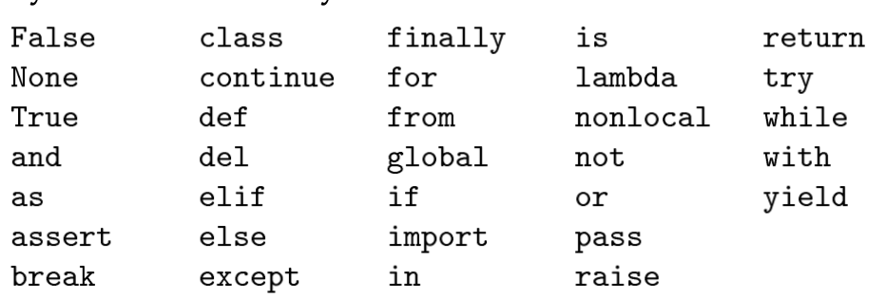
Variable name and Identifiers
Does not allow Python’s keywords
Example: class = ‘Class A’
Python 3 has these keywords

Slide 18
Data type conversion

Slide 19
Data type conversion
In order to convert between data type, we can be done by casting type with built-in function below:
int()
float()
bool()
str()

Slide 20
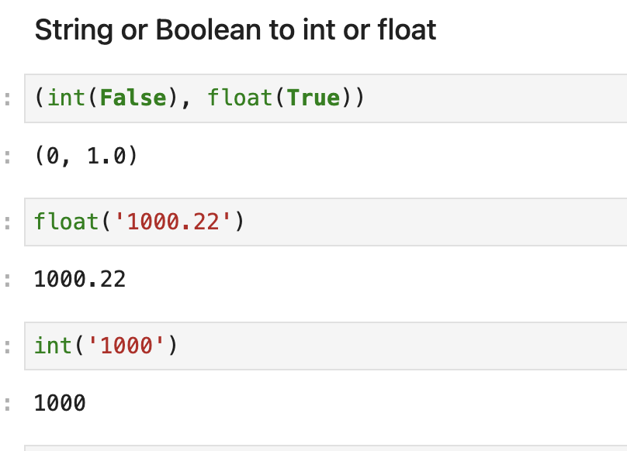

Slide 21
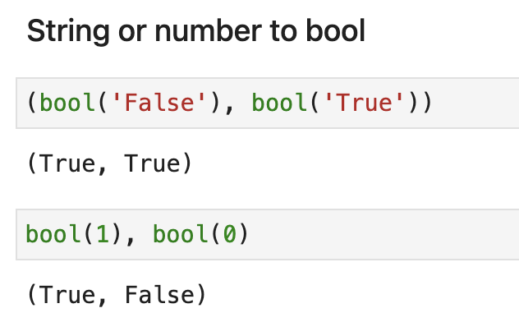

Slide 22
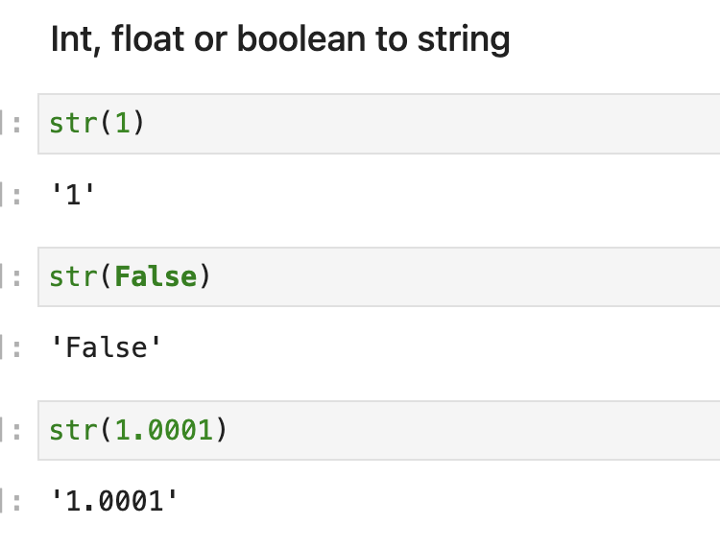

Slide 23
Practices

Slide 24
Practices
Open Jupyter Notebook
Create new Notebook
Declare 2 variable with value of ‘’’12.1”, and 10
Convert them to number and sum them

